Slide 1
Perhaps you should buy things you really like!? Analyzing CSGO skins and other in-game virtual items
Aditya Singla
18HS20005

Slide 2
Abstract
In this paper, we would explore more about in-game virtual items from Counter Strike: Global Offensive (CSGO), how the drops work, the pricing of items from CSGO (as listed at the Steam community market), amongst its other features.
Keywords: Steam, CSGO, Counter Strike, community market, skins, prices

Slide 3
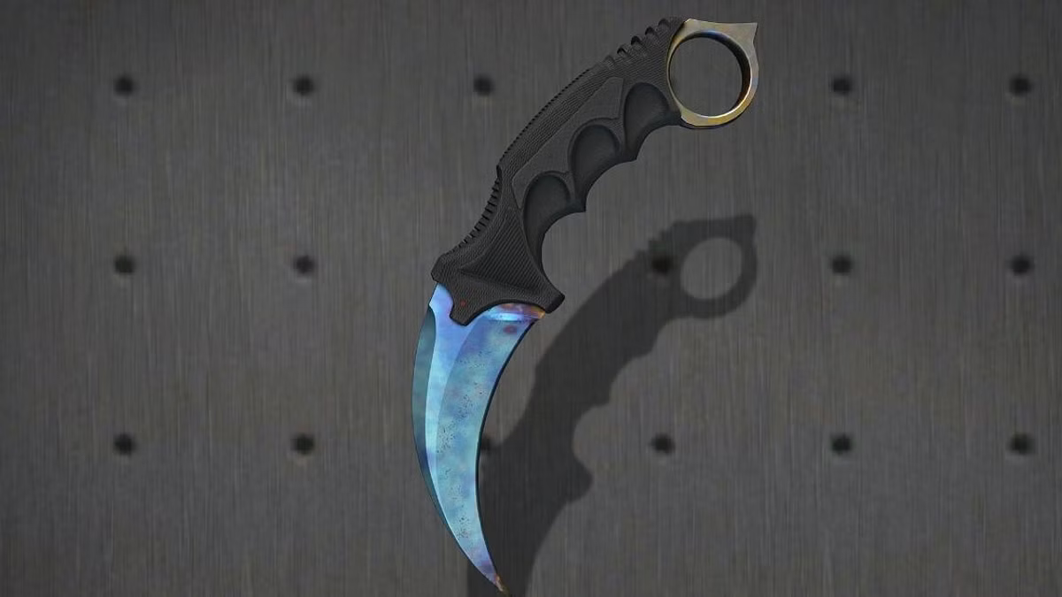
Any price guesses?

Slide 4
>$1.2 Million!

Slide 5
Holy shit!
No way! Not in any universe!

Slide 6
Well, that’s CSGO for you!

Slide 7
Wait, what in the world is csgo?
#Introduction

Slide 8
Counter Strike: Global Offensive (CSGO) is a first-person shooter game released by Valve Corp. in 2012.
But the legacy of this game start waaay back in 1999 when it was released as a mod for Half-Life.
Counter-Strike has been the de facto benchmark of a player’s first-person shooter skill. Teams from around the world demonstrate their abilities and strategies in local, regional, and international tournaments streamed to millions of viewers across the globe.

Slide 9
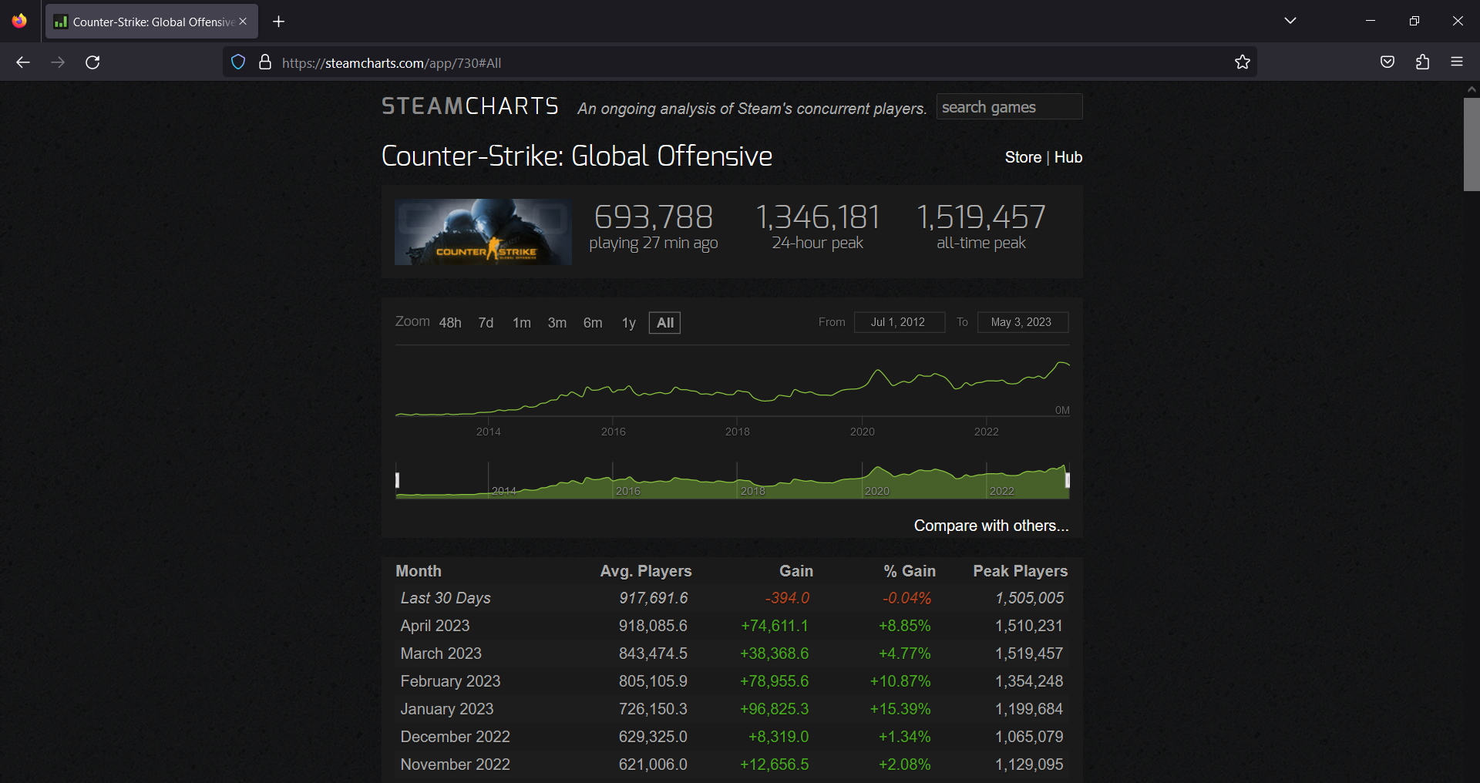

Slide 10
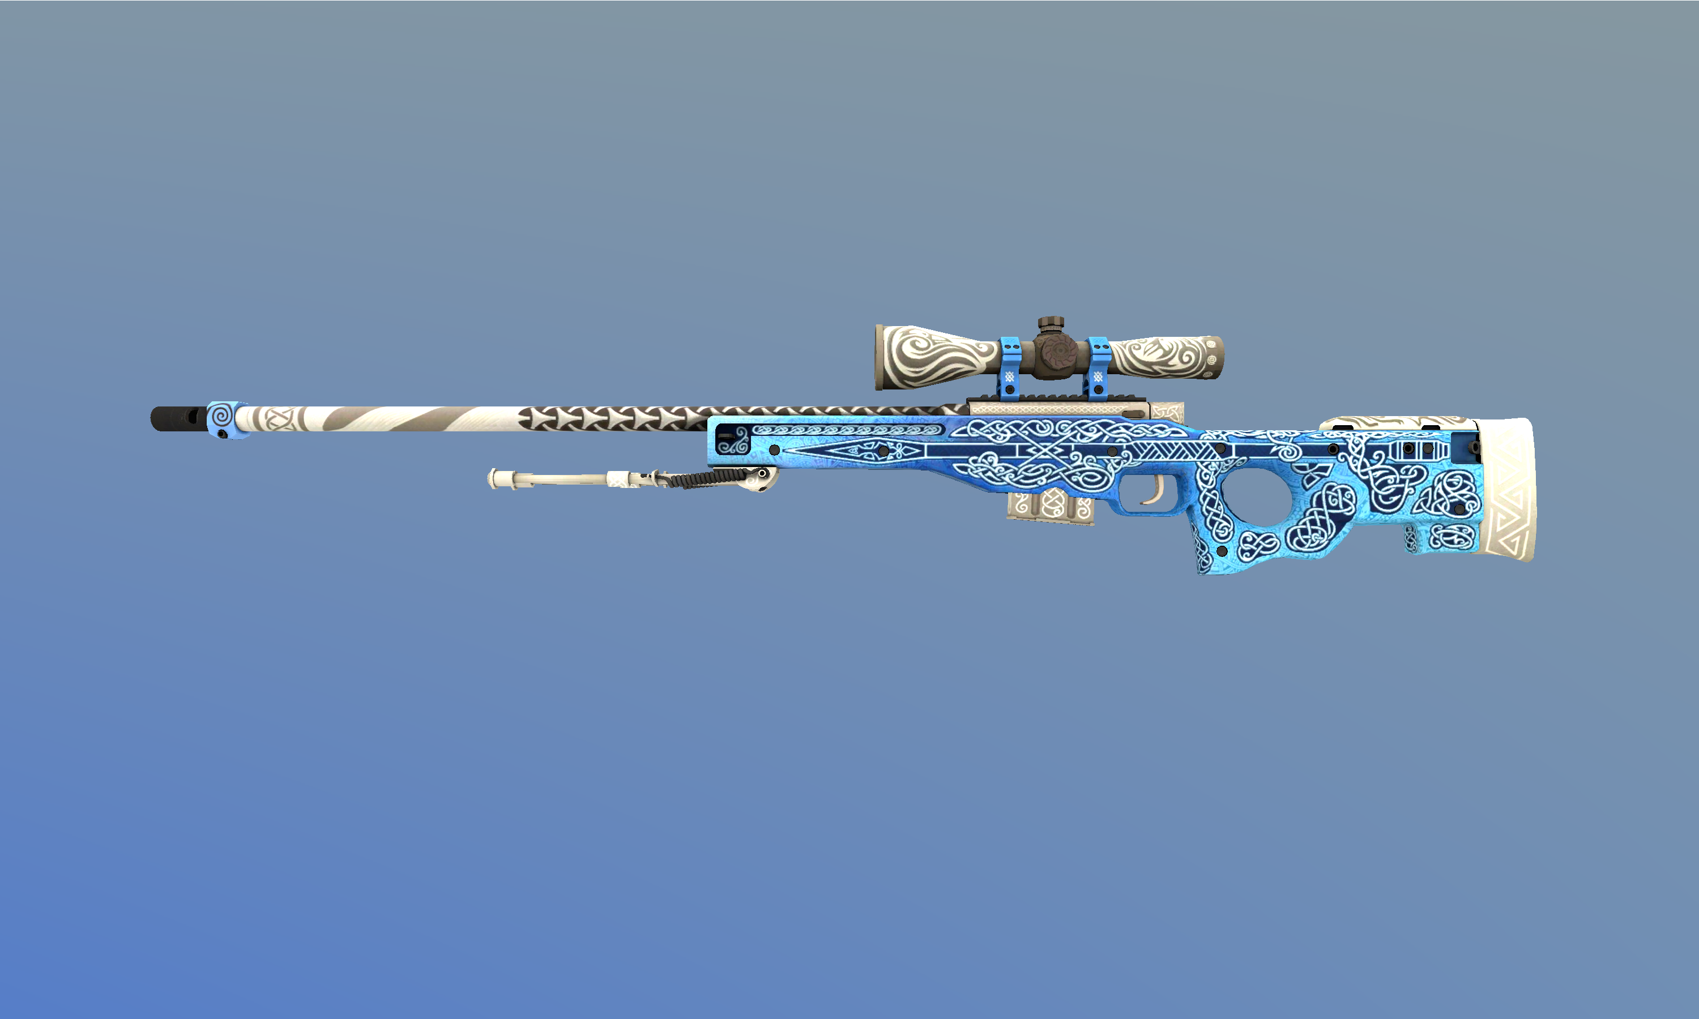
AWP Gungnir

Slide 11
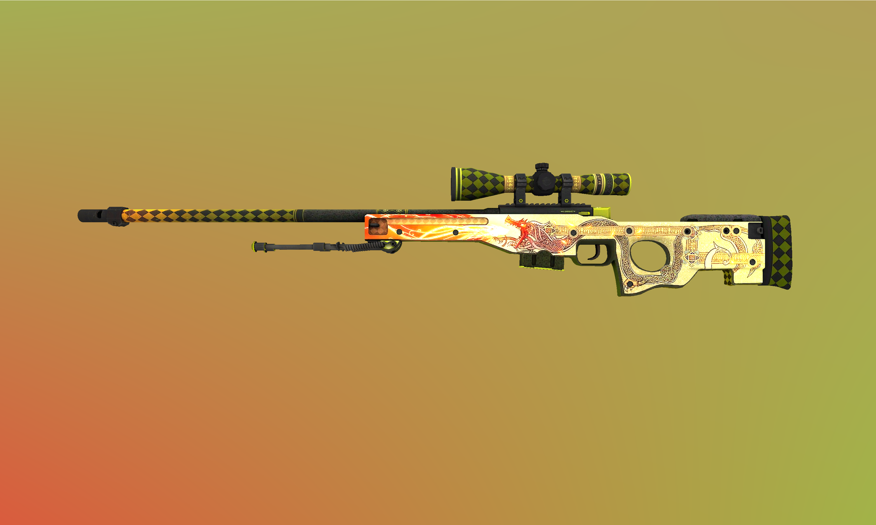
AWP Dragon-Lore

Slide 12
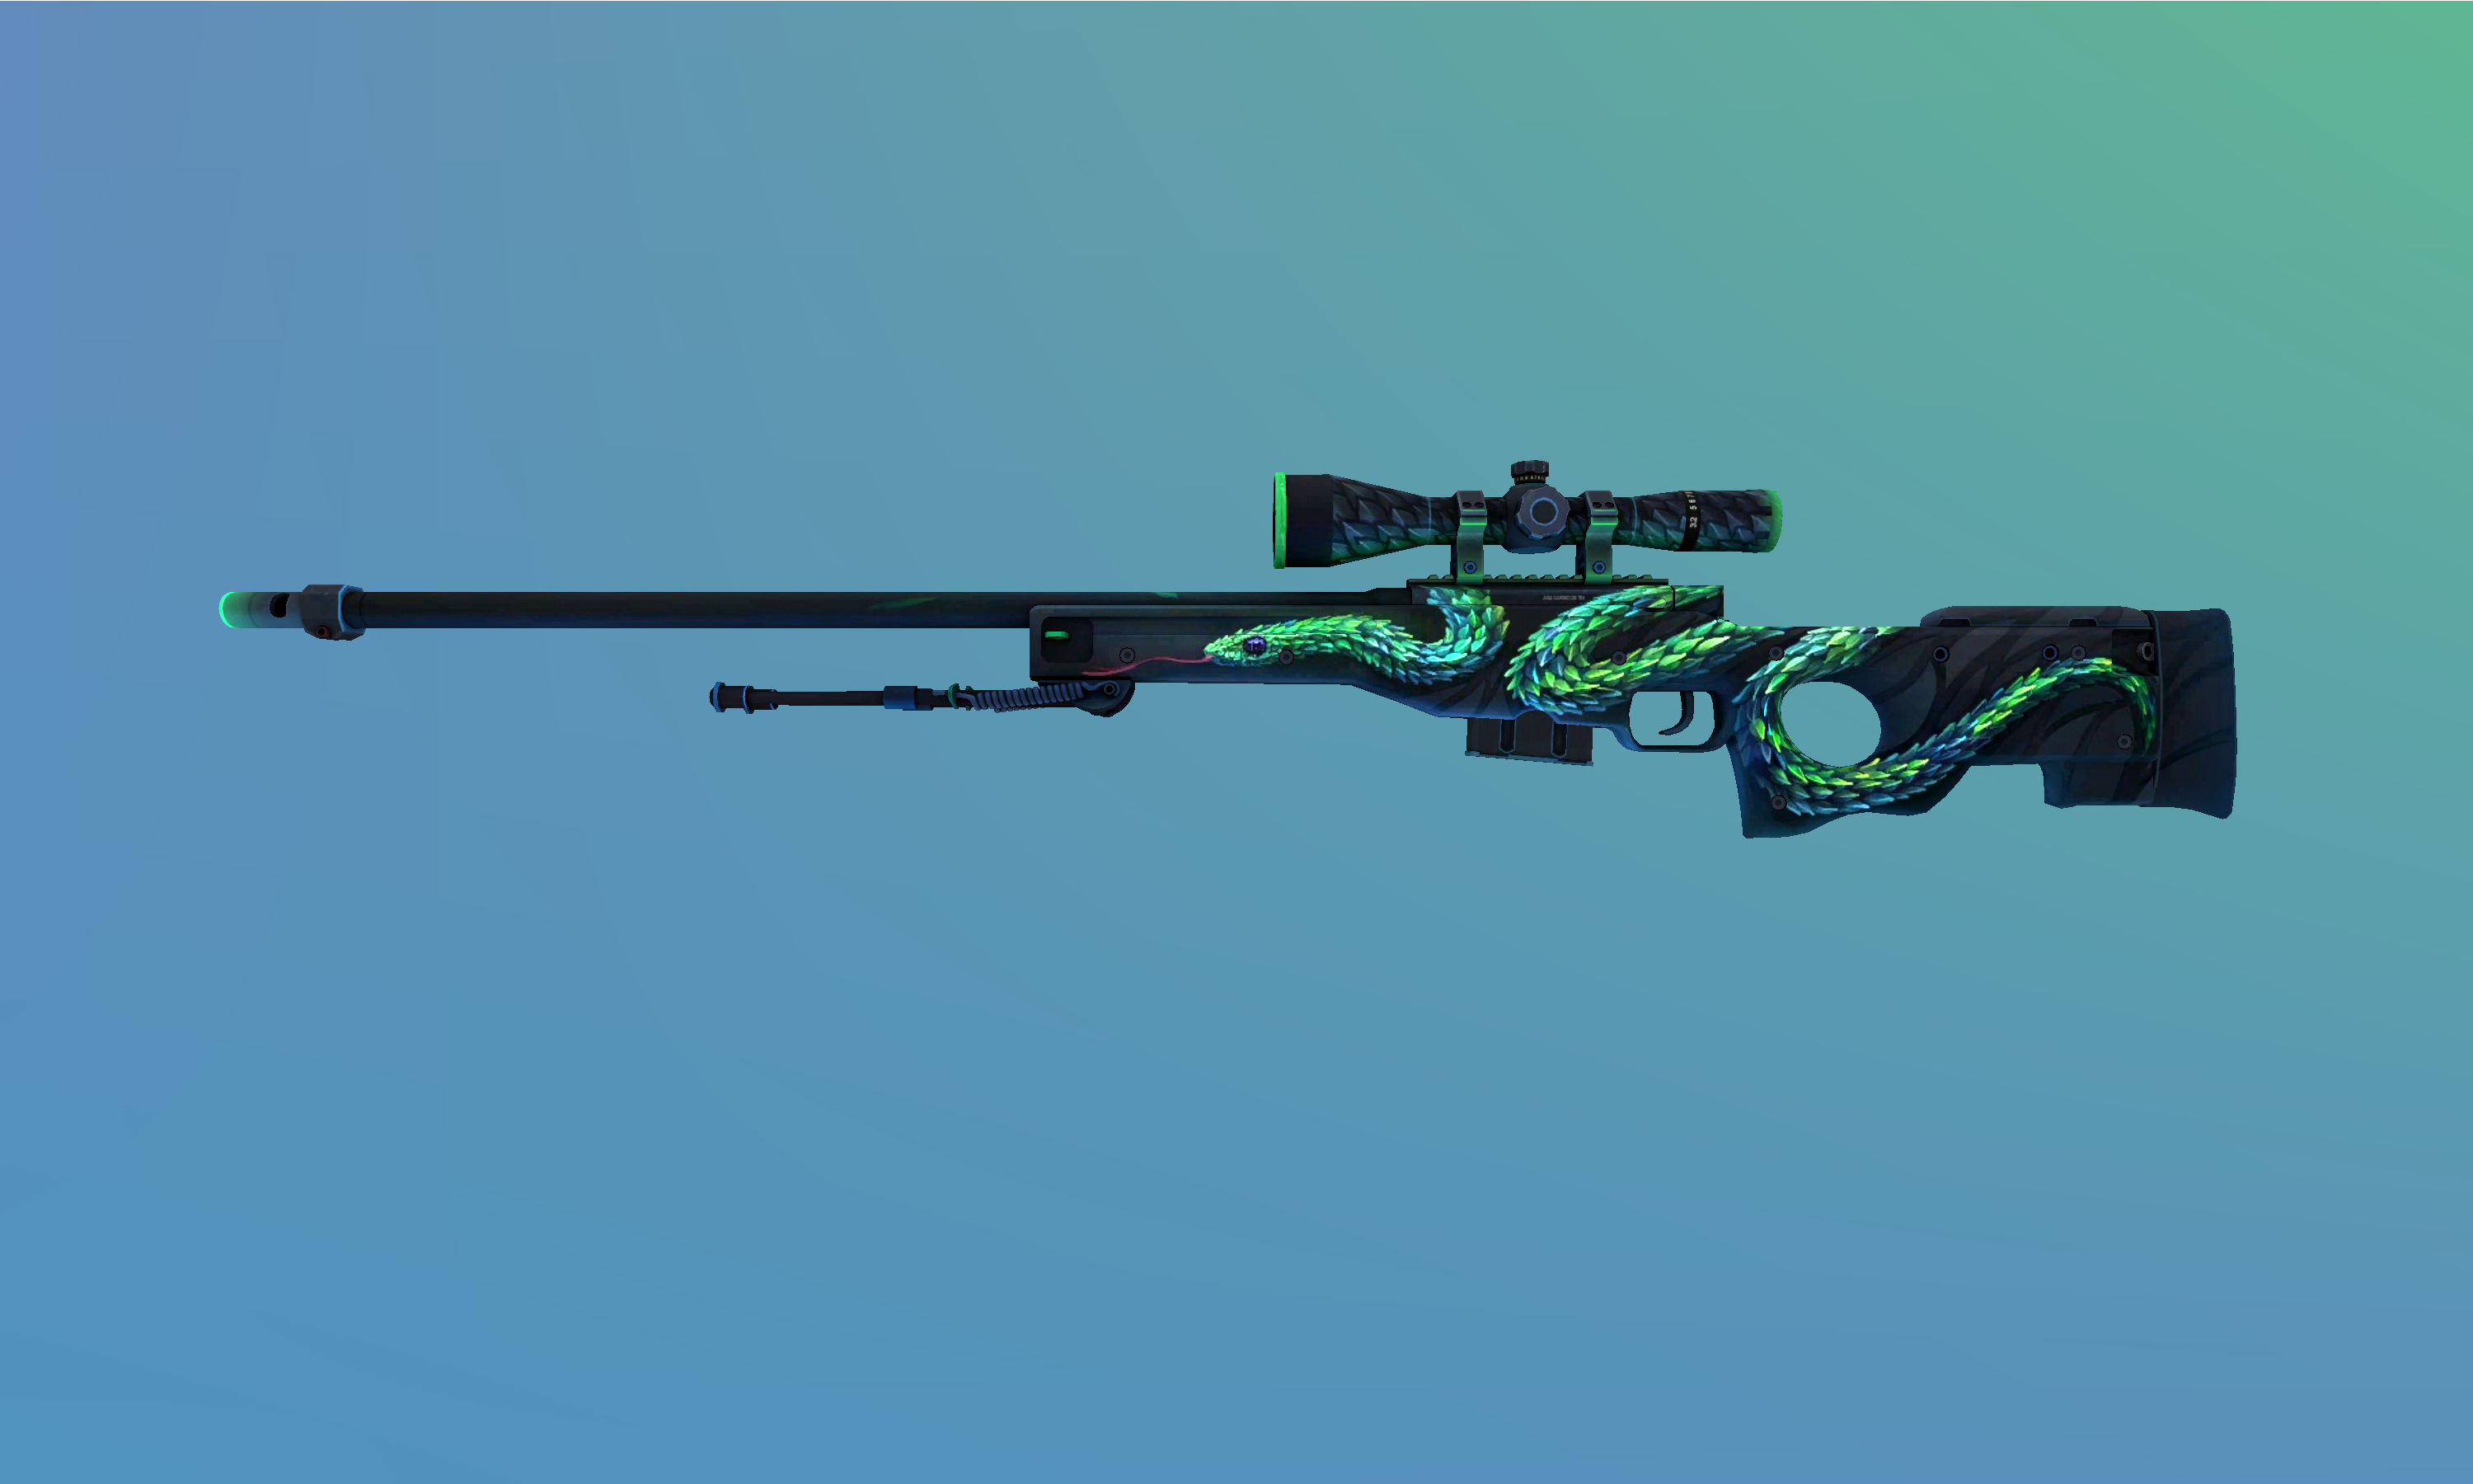
AWP Atheris

Slide 13
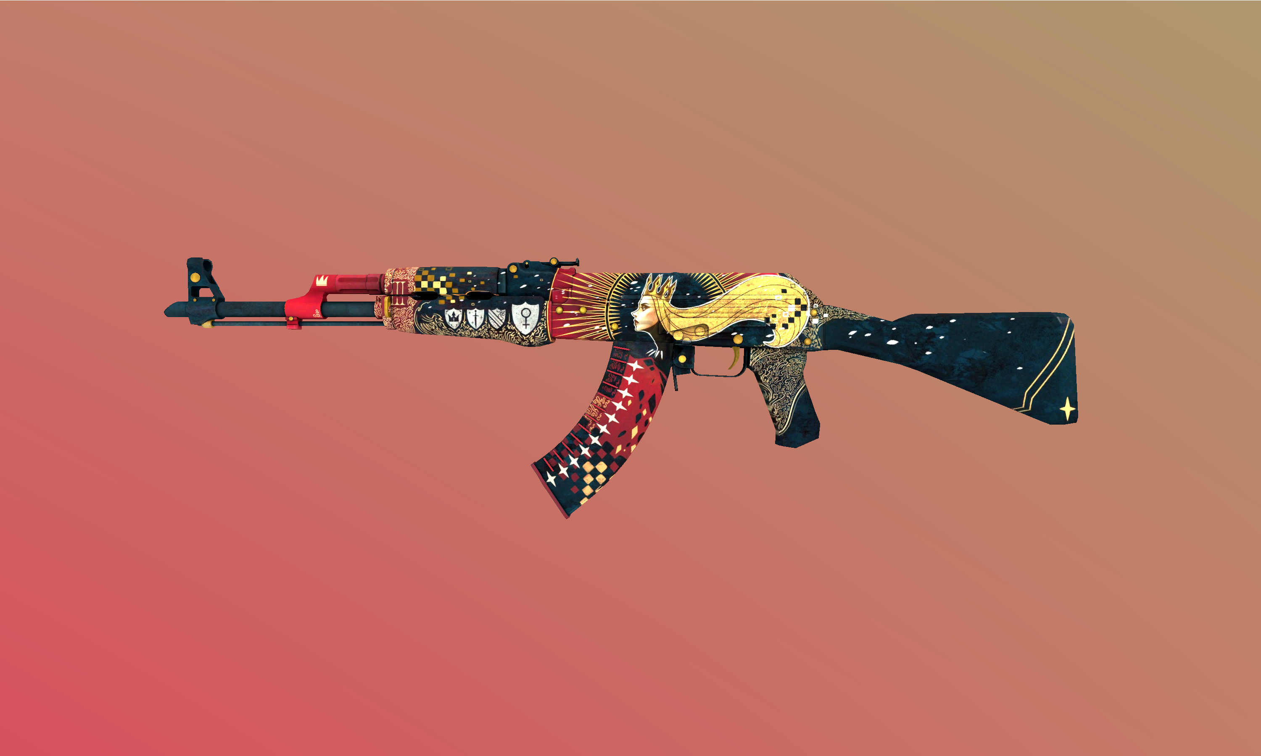
AK-47 Empress

Slide 14
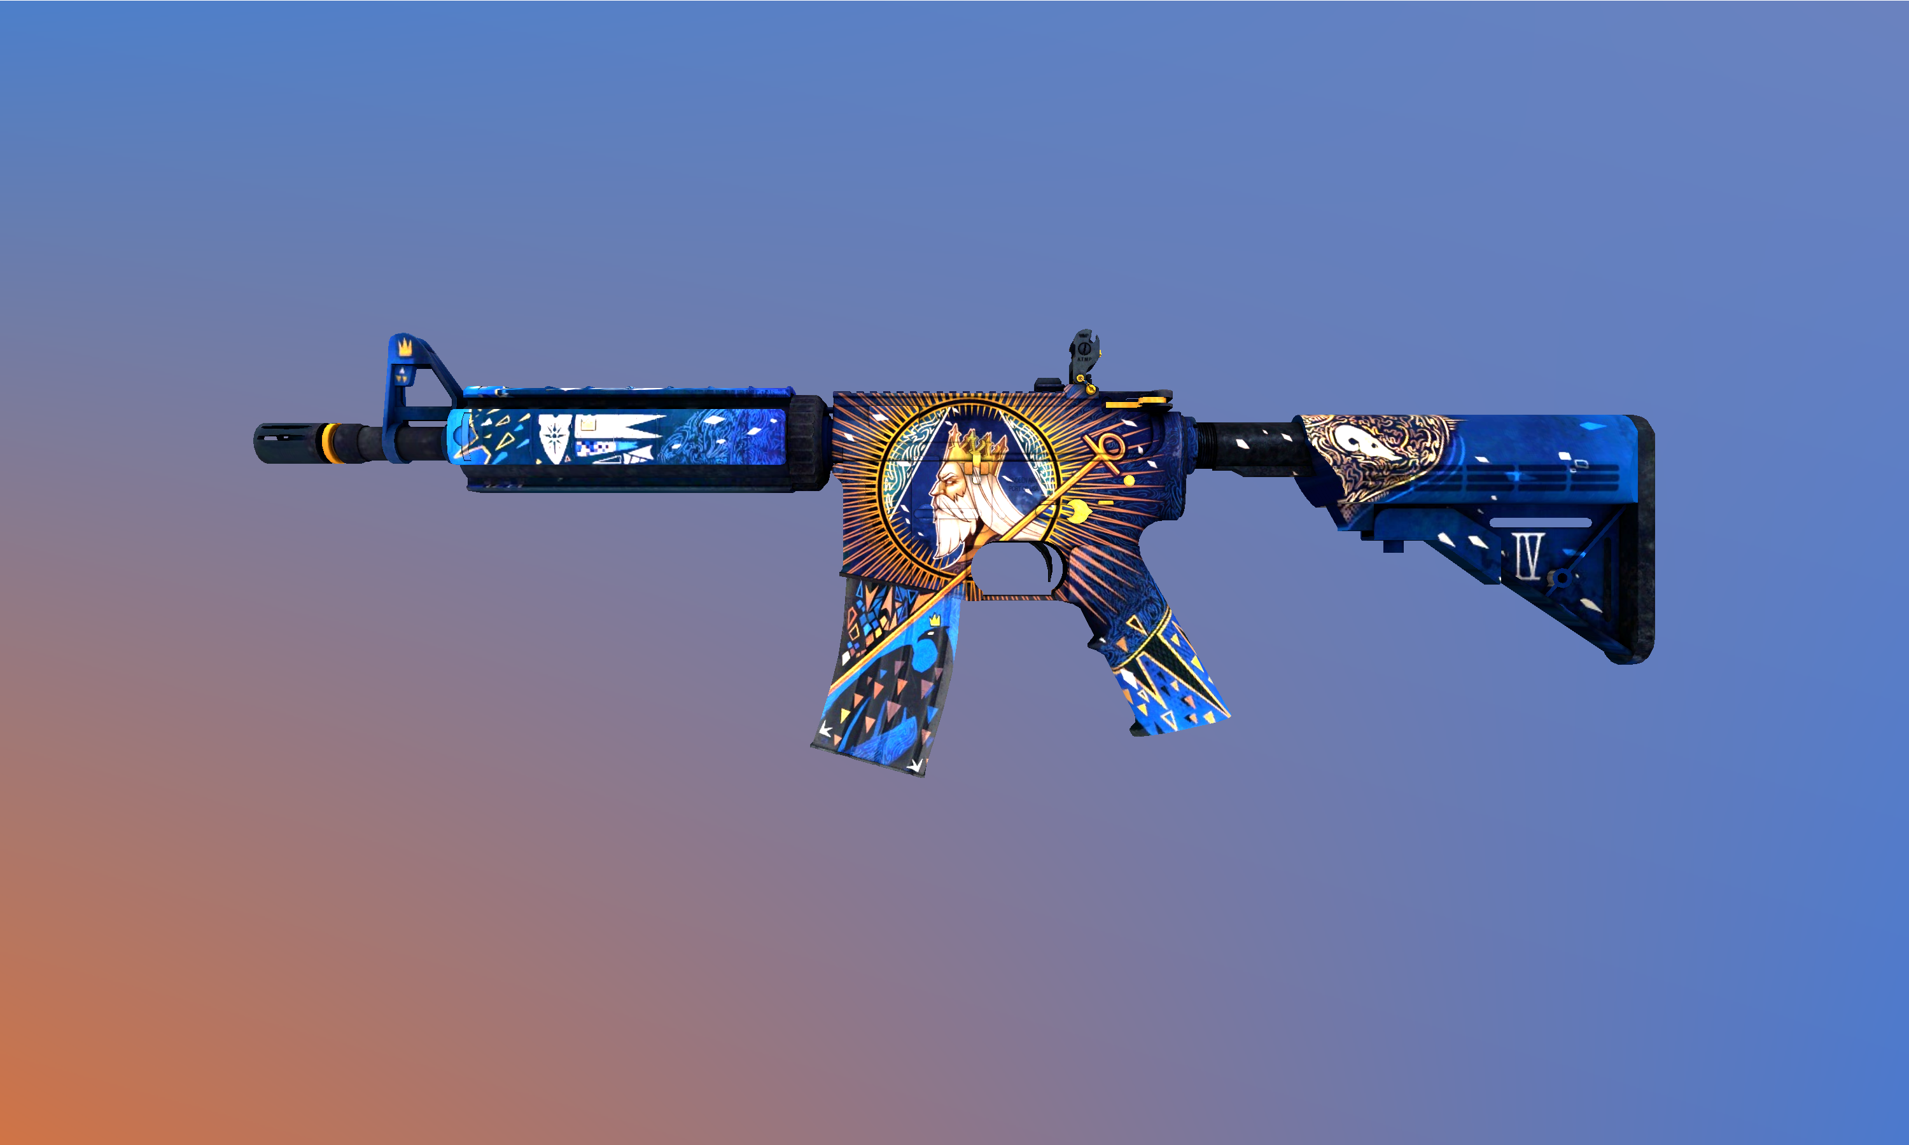
M4A4 Emperor

Slide 15
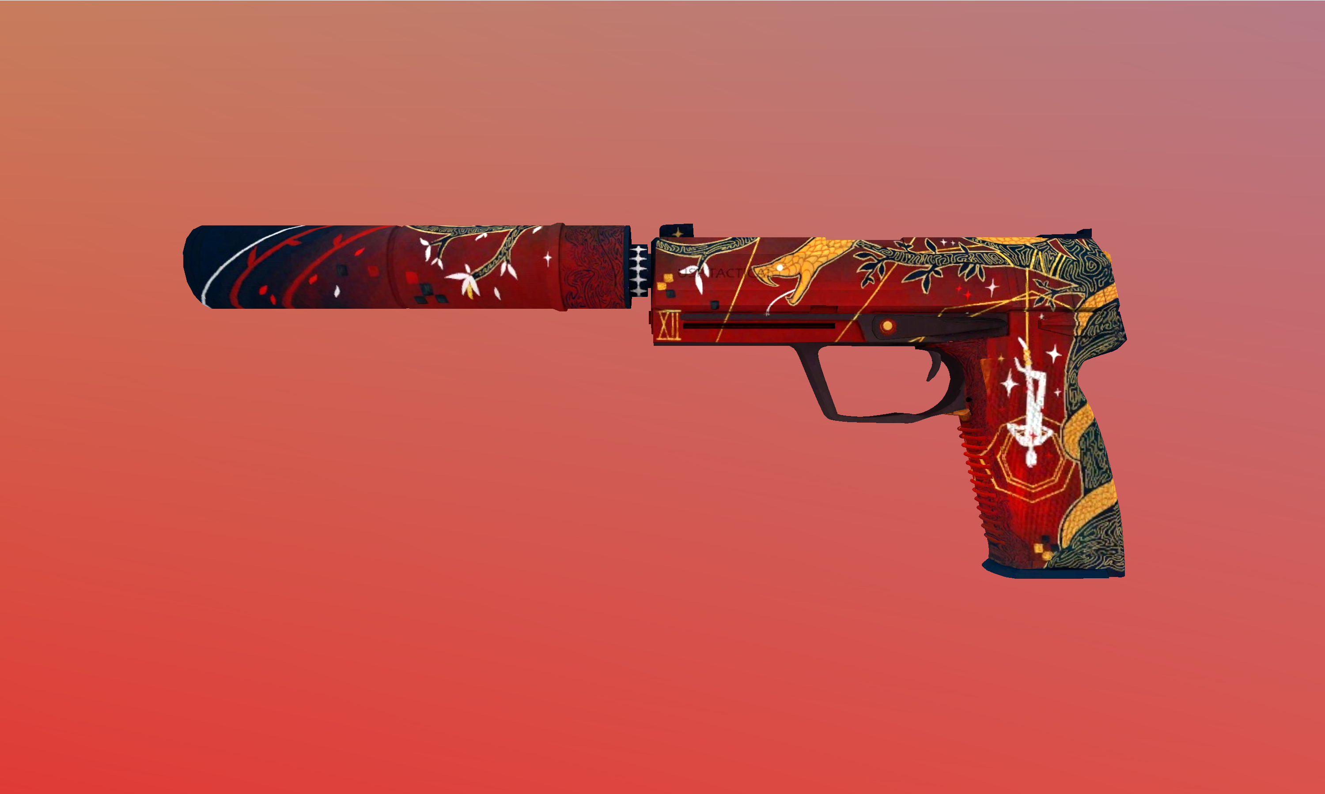
USP-S Traitor

Slide 16
What are these Virtual items? How do you get them?
#Literature Review

Slide 17
CSGO utilizes the ‘loot-box’ mechanism. That is, players can purchase a loot box (a virtual crate requiring a key to be unboxed) and a ‘key’ to open the box to get a virtual item.
These ‘loot-boxes’ are called ‘cases.’ Each of these cases contains a single item upon unboxing (virtually) confers the player a random item from a list of many items. These lists of items are different for different cases.

Slide 18
Items contained in them can be divided into 5 tiers with increasing rarity:
1) Mil-Spec (Blue)
2) Restricted (Purple)
3) Classified (Pink)
4) Covert (Red)
5) Rare Special Item (Golden)

Slide 19
Factors that determine a Skins price
#Still Literature Review

Slide 20
Skin
Float/Wear Condition (0.00-0.99)
Any specific pattern/paint index
StatTrak™ or not? Souvenir or not?
Stickers applied

Slide 21
Case Opening Odds!
#Still Still Literature Review

Slide 22
Due to the loot crate law from China’s Ministry of Culture earlier in 2016, game publishers were asked to display loot crates content and its relative odds.
These odds were as follows:
Navy Blue (Rare) – 79.92%
Purple (Mythical) – 15.98%
Hot Pink (Legendary) – 3.2%
Red (Ancient) – 0.64%
Gold (Exceedingly Rare) – 0.26%

Slide 23
Now, how many cases do I need to open to get a particular tier (blue/purple/pink/red) of item?
We’ll find that out soon enough, but first…

Slide 24
Trade-up Contract!
#Long Literature Review

Slide 25
The trade up contract is an item accessed from the player's inventory and allows players to trade 10 normal or 10 StatTrak™ weapon skins of the same weapon grade from any collection for 1 new weapon skin of the next highest-grade tier chosen randomly from one of the collections used.
Mixing weapons from different collections is also allowed, provided the skins used for the input are at the same tier. The resulting weapon skin will be randomly chosen from one of the input collections.

Slide 26
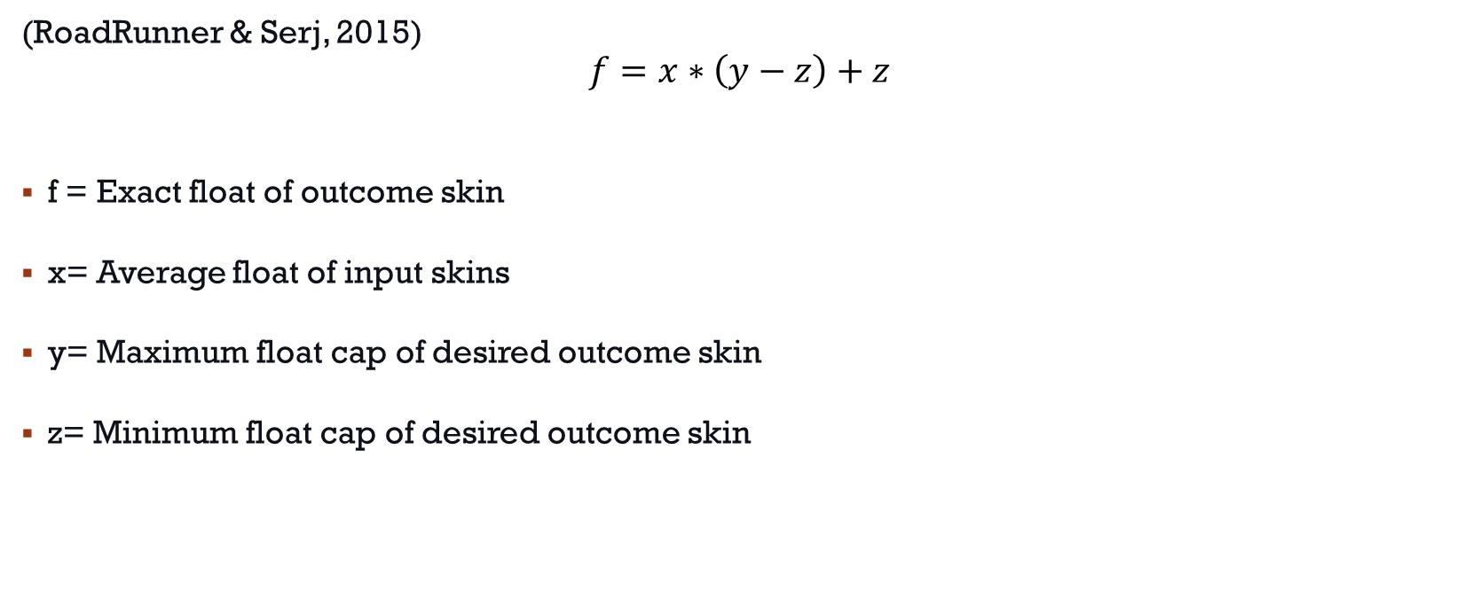
Formula for Trade-up Contract
(RoadRunner & Serj, 2015)
$$f=x∗\left(y−z\right)+z$$
f = Exact float of outcome skin
x= Average float of input skins
y= Maximum float cap of desired outcome skin
z= Minimum float cap of desired outcome skin

Slide 27
Research Gaps
#Finally Literature Review Ends

Slide 28
The Steam community market as much as it’s an active topic of research, unfortunately (and to my surprise) there’s been absolutely zero research that concerns with the pricing of the skins, cases etc. with respect to the supply and demand considerations as well as utilizing trading strategies based on the past and predicted future market behavior.
Also, the mechanism of trade-up contract is itself a fascinating one and again, no research (at least at the time of writing this) has explicitly dealt with it and walked through some of the strategies along with studying its impact on the overall skins market which in my opinion they most definitely have!

Slide 29
Methodology & Results
#The meat and the bones

Slide 30
Bernoulli Trials Method
We’ll apply the Bernoulli Trials Model to ascertain the minimum number of trials (case unboxings) that we need to perform to guarantee a certain percentage that we win. (Getting our desired skin)
N -> No. of trials to be undertaken
p -> Probability of success on each trial
θ -> Threshold odds (or the minimum percentage that I would like, for e.g., if I would like to get the particular skin with 80% probability, θ =0.8)

Slide 31
P (getting at least 1 quantity of the desired skin) = 1 – P (getting no quantity of the desired skin)
=1 – (1-p)^{N}
This probability should be greater than the minimum threshold which is θ. This value of the θ depends on the investor preference, so, if I like to take very less risks, I may like to have θ ≥ 0.95. For relatively more risk takers, θ around 0.7 may be sufficient.

Slide 32
So, P (getting at least 1 quantity of the desired skin) ≥ θ
=> 1 – (1-p) ^{N} ≥ θ
=> 1 - θ ≥ (1-p) ^{N}
=> log (1- θ) ≥ log (1-p) ^{N}
=> log (1- θ) ≥ N*log (1-p)
=> N ≥ log (1- θ)/ log (1-p)

Slide 33
Let’s take an example to test our theory.
Take the gold-tier items (Knives/gloves)
p = 0.26% = 0.0026
Let θ = 95% = 0.95 (that is, I would like to have a 95% chance of getting at least 1 knife if I open N number of cases)
=> N ≥ log (1- θ)/ log (1-p)
=> N ≥ log (0.05)/ log (0.9974)
=> N ≥ 1150.70
So, a minimum of 1151 cases should be opened to have an odds of 95% of getting at least 1 knife/glove !!

Slide 34
Now, as we said earlier, to open a case, we need a case and a key to open. The price of the key is the exact same all across the globe, for all cases in CSGO.
Let the key price = k,
Case price = c (c is usually different for different cases and even varies over time)
Now, for each trial (unboxing), the player spends (c+k) money
So, total money spent unboxing at least 1 knife/glove with 95% certainty = N*(c+k)
In India, k = ₹196 ($2.5) , c = ₹60 (as of 4:15 am, 3/05/23)
So, total money spent = 1151*1(196+60) = ₹294,656
Average knife price (from fracture case) = ₹49,200
Clearly, being the average doesn’t cut it. The best way is to instead see what the risk percentage (instead of our 95%) is the market willing to take.

Slide 35
So, N = Total Money Spent/(c+k) = Average knife price/(c+k) = 49,200/254 = 193.70
=> N = 194
Now, 1 – (1-p) ^{N} ≥ θ
=> 1- (1-0.0026)¹⁹⁴ ≥ θ
=> θ≤ 1-(0.9974)¹⁹⁴ = 0.397
This suggests that the market is confident of getting a knife in fracture case at just 40% odds which in my opinion are not good.

Slide 36
Trading Strategies
#Damn that was loong!
#Trade secrets

Slide 37
Overflooding the operation case supply at the very beginning of the operation so that we supply until the price drops below cost. After it goes to the minimum, use all the capital renewed by selling the initial cases and profit to buy them at a very cheap price. Hold these cases for a long time after. (#game theory)
Buying CSGO cases near a major. Since people like to free up the available capital to buy major passes+ souvenir cases, they do so by selling these cases. A large number of cases are sold in the market for the first time, making it an opportune moment to buy such cases.
Due to case rotation in the active drop pool, buy the case expected to go into the rare drop pool far earlier than it officially goes. After it enters the rare drop pool, the supply practically remains the same whilst the demand still rises. (or even if it remains the same, over time the supply WILL start to get low)

Slide 38
Use the principle of Relative Valuation to find undervalued cases! Since the market tends to get dictated by quite the FOMO, items that are in trend tend to remain so only in the short term whilst in the meantime, other items are cheaper to pick up. For example, picked up Dreams & Nightmare case for ₹50/- each (in January-February 2023) back when I discovered that they could be unboxed to get the butterfly knives (the most desirable in CSGO history) and other cases (Spectrum 1 and Spectrum 2 Case) having similar butterfly knives were already around ₹80-100 each. Though the catch was that D&M Case was in the active duty drop pool while Spectrum cases were already in the rare drop pool. But in the long term, I expected people to remain high/long on the Butterfly knives so I bought 850 D&M Cases. The current price of D&M Cases are around ₹150/- each. It also helps that the D&M case has the exact same knives as the Operation Riptide Case (the operation ended on 20th February 2022 and hence no more new supply of those case knives are possible except ONLY from the D&M Case)
The above strategy also works wonders well for the Fracture Case! Have the same knives as the Shattered Web Case from the Operation Shattered Web (ended on 30th March 2020). Bought them for ₹15-20 each and 1182 in quantity. Current price is ₹80 and is also being expected to be the next case in the rare drop pool where after it enters, I expect it to go even higher.

Slide 39
Have an eye for elegant design! Not everyone can figure out the nice skins that easily and having a better both long term and short-term judgement would work wonders for you! For example, AWP Gungnir (Yes, the Odin’s Spear blue and silver skin I showed in the beginning) was launched only in 2019 and finished dropping when the Operation Shattered Web ended as part of the Norse Collection. In my opinion, that’s the best AWP skin ever made in CSGO yet (and much better than the Dragon Lore in my opinion) and combined that with the fact that it was only an operation exclusive skin, it’s no surprise to me that it’s the most expensive AWP skin in the world (not counting in souvenir AWPs with famous signatures or exquisite sticker craft on such AWPs). Wish I had the capital to buy it back then but I did not know about the CSGO skin…
Have some good luck. After all the boon of all good investments from being good to great/extraordinary does involve a fair share of luck (in my case the announcement of CS2 on 22nd March 2023 along with the fact that all the skins would also be ported signaling that Counter Strike as a franchise is here for the long term has quite a positive effect on the prices of every desirable item on the CSGO market)

Slide 40
Ok, all well and good! But how much did you make? Why should I listen to you?
#haters gonna hate hate hate

Slide 41
#money
Portfolio Cost = ₹1.5L
Portfolio Value = ₹5L

Slide 42
Conclusion
#hope people are still interested

Slide 43
We saw that the market is confident of getting a knife in fracture case at just 40% odds which in my opinion are not good. Or in other words, a rational person would never like to play with such low odds. In other words, the typical person in the market opening fracture cases is more like a gambler and not an investor.
(Why in the world didn’t I write this report before I decided to open 20 of these cases :-<)
Secondly, we also saw that it is far more viable to make money via CSGO trading rather than opening cases like a gambler. Much better returns which can easily buy stuff (at least in a longer term) which the typical gambler would want to buy too except in the short run.

Slide 44
Discussion
#potential dangers lurking

Slide 45
As much as trading skins, stickers cases in CSGO is financially viable, we must see, that at the end of the day, the value of these skins fundamentally stems from the fact that there is huge player-base of CSGO (and the Counter Strike series in general) with a very healthy ecosystem of E-Sports in which CSGO is the top premier title along with the League of Legends (by Riot Games) with huge Organisations like Cloud9, G2, Team Liquid etc. with valuations around $500M (Knight, 2022) and expected to grow in the future, CSGO (or perhaps CS2) skins seem like a very good long-term investment, although carrying risks of different types than the typical risks one is faced in the capital markets.

Slide 46
Further Research Avenues
#actually million dollar question

Slide 47
Efficient Packing Problem
Yes, I just coined this term ;)
And the problem too :>

Slide 48
A problem to find viable 2nd and 3rd order trade-up contracts.
For a trade-up contract, 10 skins of the same tier led to a skin of the next tier, which is well understood. Naturally, due to market forces, this next tier skin would have the price less than or equal 10*(Price of the cheapest skin in the lower tier)
So, it’s not worth it to put 10 skins of the same collection to get the next best skin of the same collection
Luckily CSGO, also allows us to mix the collection in the trade-up contract. So, instead of taking 10 skins of the same collection, maybe I take only 9 skins of the same collection and 1 skin of some other collection (but of the same tier as the 9 others, so for e.g., if the 9 skins are pink, the other ‘impurity skin’ must be also pink). So, I could get around 90% odds to get the same red skin that I desired but at 9/10th of the price only (assuming the cost of the impure skin is quite small compared to the other main skin).
Naturally, 90% odds with 9/10th of the cost is too easy of a deal to pass by which is why people will become greedier to try their luck now at 80% odds with 8/10th price this time. And after then, even 70% odds at 7/10th the price.
Though now, we must be very careful now that for 70% odds, there’s a 30% chance that we lose all the money and instead get something worth practically nothing. It’s been mostly observed for a lot of the skin items that the next higher tier item is typically between (70-80%) of the lowest priced item of the just lower tier.

Slide 49
But that was for just a 1-tier upgrade. What if we want a 2-tier upgrade?
Naturally, we would need at the worst case 100 skins (say purple tier) to get 1 red tier skin. The way it would work is that I’ll divide 100 purple skins into 10 boxes of 10 skins each. Then apply the trade-up contract to each of these boxes to finally get 10 pink tier skins from all the boxes. Then, I apply another final trade-up contract of these 10 pink skins to get the desired red skin.
But the worst case is 100...Surely, we can do far better, no? In other words, we are in search of an ‘optimal’ number of skins that, when packed in a certain way, gives me the best risk-reward ratio!

Slide 50
However, this problem is far more complex than it appears on the surface. Firstly, we are not limited to a single collection of ‘impurities’. In order to rig the odds slightly into our favour, we may utilise ‘filler’ skins which are basically impurities but in which the tier we desire has the least number of red outcomes. (It’s been found out that the probability just doesn’t depend on the number of inputs we use, but also the ‘quality’ of inputs. In short, if an input has much more available red skins, then the output would have a slightly better chance of being from the collection which has more red skins available.)
Now, in essence we must partition the available skins in such a way that when combing through the trade up contracts via filler skins, other impurities etc., gives me the maximum probability to get the red tier (in this case). We can extend the process to even 1000 skins where we go from blue to red.
If we can somehow manage to solve this problem or figure out the optimal way and I’m pretty sure that our ‘optimal’ solution would certainly beat the market risk-reward ratio, this solution is potentially worth millions of dollars.

Slide 51
References
#thank you to all these beautiful people

Slide 52
Knight, B. (2022, May 6). The Most Valuable Esports Companies 2022. Forbes. Retrieved May 3, 2023, from https://www.forbes.com/sites/brettknight/2022/05/06/the-most-valuable-esports-companies-2022
Perfect World Co. Ltd. (2017, September 11). 概率公示- CSGO官方网站. 反恐精英:全球攻势. Retrieved May 3, 2023, from https://www.csgo.com.cn/news/gamebroad/20170911/206155.shtml
RoadRunner, & Serj. (2015, April 5). Guide :: Exteriors/Wears in Trade Up Contract. Steam Community. Retrieved May 3, 2023, from https://steamcommunity.com/sharedfiles/filedetails/?id=420402033
Valve Corporation. (n.d.). Counter-Strike: Global Offensive » About. Counter-Strike: Global Offensive. Retrieved May 3, 2023, from https://blog.counter-strike.net/index.php/about/
Valve Corporation. (2023, March). Counter-Strike 2 | Limited Test. Counter-Strike.net. Retrieved May 3, 2023, from https://www.counter-strike.net/cs2

Slide 53
The End!
Any questions?
#Don’t know what more to write

